Slide 1
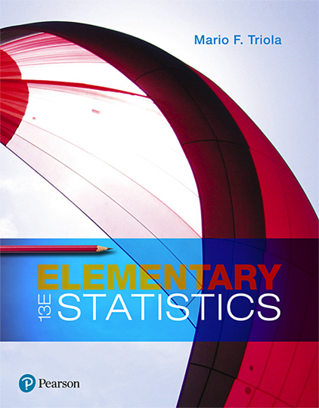
Elementary Statistics
Thirteenth Edition
Chapter 7
Estimating Parameters and Determining Sample Sizes
Copyright © 2018, 2014, 2012 Pearson Education, Inc. All Rights Reserved

Slide 2
Estimating Parameters and Determining Sample Sizes
7-1 Estimating a Population Proportion
7-2 Estimating a Population Mean
7-3 Estimating a Population Standard Deviation or Variance
7-4 Bootstrapping: Using Technology for Estimates

Slide 3
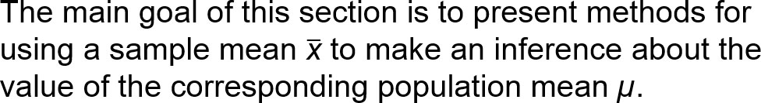
Key Concept (1 of 2)

Slide 4
Key Concept (2 of 2)
There are three main concepts included in this section:
Confidence Interval: Use sample data to construct and interpret a confidence interval estimate of the true value of a population mean µ.
Sample Size: Find the sample size necessary to estimate a population mean.

Slide 5
Confidence Interval for Estimating a Population Mean with σ Not Known: Objective
Construct a confidence interval used to estimate a population mean.

Slide 6
Confidence Interval for Estimating a Population Mean with σ Not Known: Notation
µ = population mean
n = number of sample values
E = margin of error
s = sample standard deviation

Slide 7
Confidence Interval for Estimating a Population Mean with σ Not Known: Requirements
The sample is a simple random sample.
Either or both of these conditions are satisfied: The population is normally distributed or n > 30.

Slide 8

Confidence Interval for Estimating a Population Mean with σ Not Known: Confidence Interval (1 of 2)
Margin of Error:
Confidence Interval: The confidence interval is associated with a confidence level, such as 0.95 (or 95%), and α is the complement of the confidence level. For a 0.95 (or 95%) confidence level, α = 0.05.

Slide 9
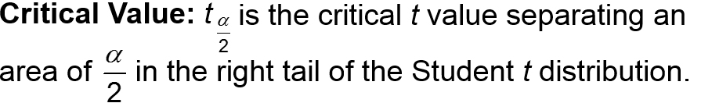
Confidence Interval for Estimating a Population Mean with σ Not Known: Confidence Interval (2 of 2)
Degrees of Freedom: df = n − 1 is the number of degrees of freedom used when finding the critical value.

Slide 10
Confidence Interval for Estimating a Population Mean with σ Not Known: Round-Off Rule
​​Original Data: When using an original set of data values, round the confidence interval limits to one more decimal place than is used for the original set of data.
​​Summary Statistics: When using the summary statistics of n, x, and s, round the confidence interval limits to the same number of decimal places used for the sample mean.

Slide 11
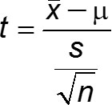
Key Points about the Student t Distribution (1 of 5)
Student t Distribution If a population has a normal distribution, then the distribution of
is a Student t distribution for all samples of size n. A Student t distribution is commonly referred to as a t distribution.

Slide 12

Key Points about the Student t Distribution (2 of 5)
In general, the number of degrees of freedom for a collection of sample data is the number of sample values that can vary after certain restrictions have been imposed on all data values. For the methods of this section, the number of degrees of freedom is the sample size minus 1.
Degrees of freedom = n − 1

Slide 13
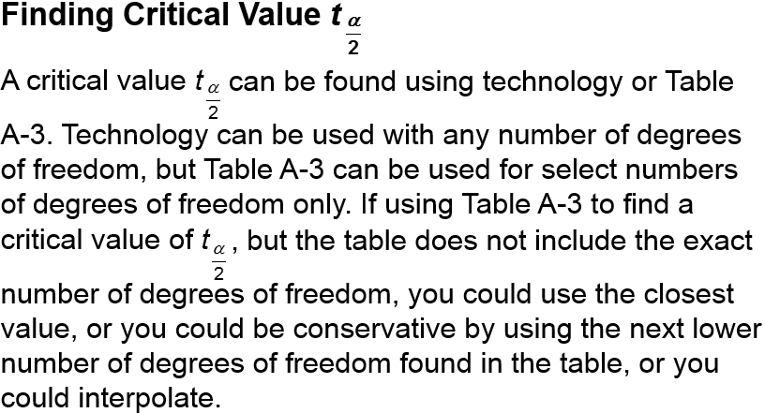
Key Points about the Student t Distribution (3 of 5)

Slide 14
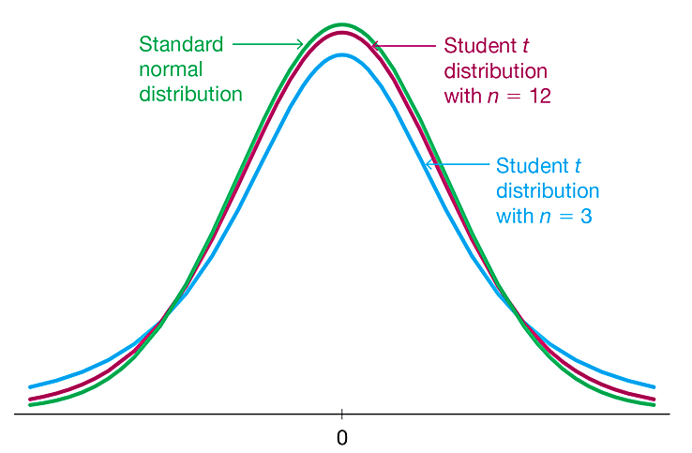
Key Points about the Student t Distribution (4 of 5)
The Student t distribution is different for different sample sizes. See the figure for the cases n = 3 and n = 12.
The Student t distribution has the same general shape and symmetry as the standard normal distribution, but it has the greater variability that is expected with small samples.

Slide 15
Key Points about the Student t Distribution (5 of 5)
The Student t distribution has the same general symmetric bell shape as the standard normal distribution, but has more variability (with wider distributions), as we expect with small samples.
The Student t distribution has a mean of t = 0 (just as the standard normal distribution has a mean of z = 0).
The standard deviation of the Student t distribution varies with the sample size, but it is greater than 1 (unlike the standard normal distribution, which has s = 1).
As the sample size n gets larger, the Student t distribution gets closer to the standard normal distribution.

Slide 16
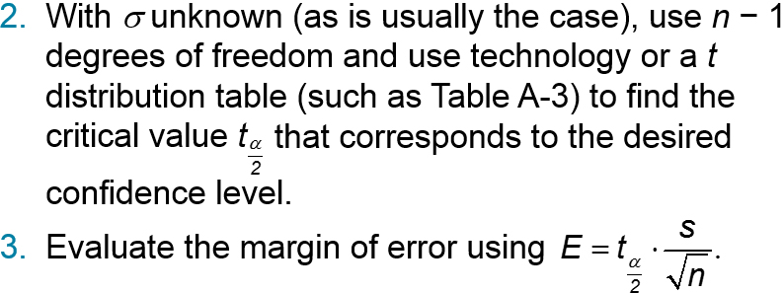
Procedure for Constructing a Confidence Interval for µ (1 of 2)
Verify that the two requirements are satisfied: The sample is a simple random sample and the population is normally distributed or n > 30.

Slide 17
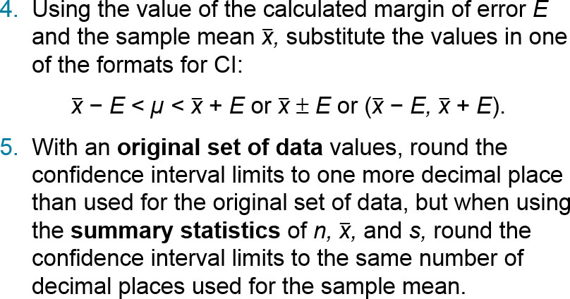
Procedure for Constructing a Confidence Interval for µ (2 of 2)

Slide 18
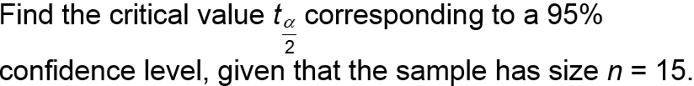
Example: Finding a Critical Value t alpha by 2 (1 of 4)

Slide 19
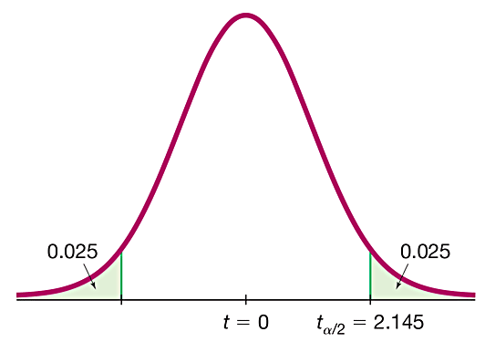
Example: Finding a Critical Value t alpha by 2 (2 of 4)
Solution
Because n = 15, the number of degrees of freedom is n − 1 = 14. The 95% confidence level corresponds to σ = 0.05, so there is an area of 0.025 in each of the two tails of the t distribution, as shown.

Slide 20
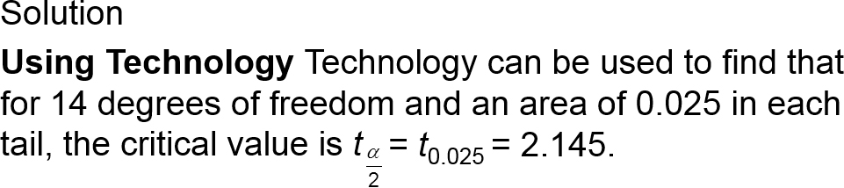
Example: Finding a Critical Value t alpha by 2 (3 of 4)

Slide 21
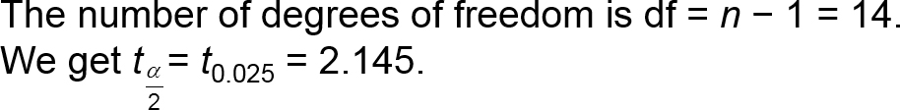
Example: Finding a Critical Value t alpha by 2 (4 of 4)
Solution
Using Table A-3 To find the critical value using Table A-3, use the column with 0.05 for the “Area in Two Tails” (or use the same column with 0.025 for the “Area in One Tail”).

Slide 22
Finding a Point Estimate and Margin of Error E from a Confidence Interval
Point estimate of µ:
Margin of error:

Slide 23
Finding the Sample Size Required to Estimate a Population Mean: Objective
Determine the sample size n required to estimate the value of a population mean µ.

Slide 24
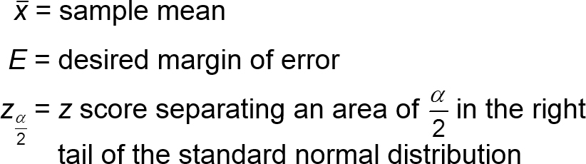
Finding the Sample Size Required to Estimate a Population Mean: Notation
µ = population mean
σ = population standard deviation

Slide 25
Finding the Sample Size Required to Estimate a Population Mean: Requirement
The sample must be a simple random sample.

Slide 26
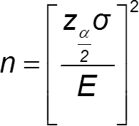
Finding the Sample Size Required to Estimate a Population Mean: Sample Size
The required sample size is found by

Slide 27
Finding the Sample Size Required to Estimate a Population Mean: Round-Off Rule
If the computed sample size n is not a whole number, round the value of n up to the next larger whole number.

Slide 28
Dealing with Unknown σ When Finding Sample Size
Use the range rule of thumb to estimate the standard deviation as follows: σ ≈ range/4, where the range is determined from sample data.
Start the sample collection process without knowing σ and, using the first several values, calculate the sample standard deviation s and use it in place of σ. The estimated value of σ can then be improved as more sample data are obtained, and the sample size can be refined accordingly.
Estimate the value of σ by using the results of some other earlier study.

Slide 29
Example: IQ Scores of Statistics Students (1 of 3)
Assume that we want to estimate the mean IQ score for the population of statistics students. How many statistics students must be randomly selected for IQ tests if we want 95% confidence that the sample mean is within 3 IQ points of the population mean?

Slide 30
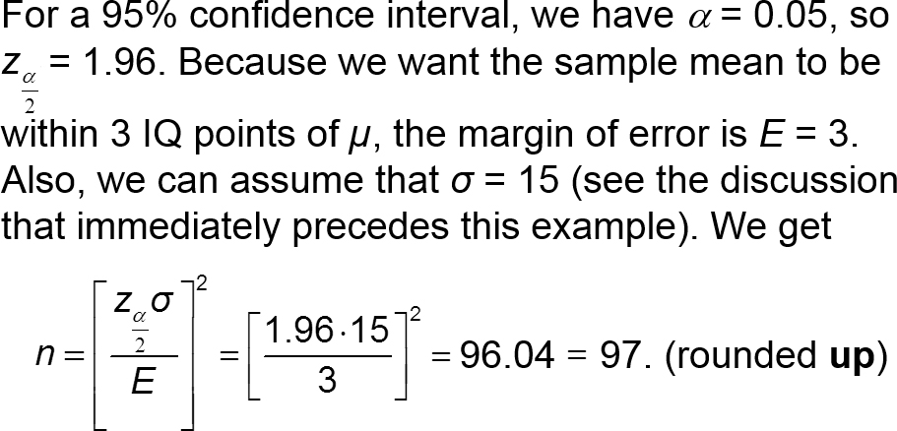
Example: IQ Scores of Statistics Students (2 of 3)
Solution

Slide 31
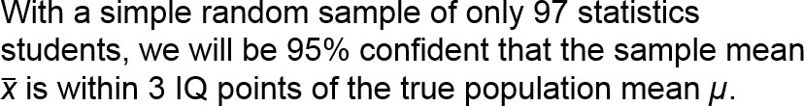
Example: IQ Scores of Statistics Students (3 of 3)
Interpretation
Among the thousands of statistics students, we need to obtain a simple random sample of at least 97 of their IQ scores.

Slide 32

Estimating a Population Mean When σ Is Known
If we somehow do know the value of σ, the confidence interval is constructed using the standard normal distribution instead of the Student t distribution, so the same procedure can be used with this margin of error:

Slide 33
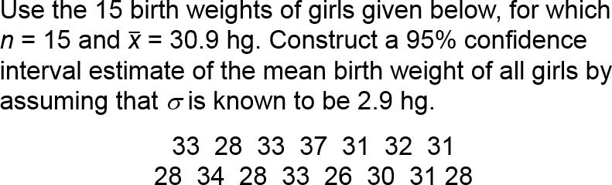
Example: Confidence Interval Estimate of µ with Known σ (1 of 6)

Slide 34
Example: Confidence Interval Estimate of µ with Known σ (2 of 6)
Solution
Requirement Check: (1) The sample is a simple random sample. (2) Because the sample size is n = 15, the requirement that “the population is normally distributed or the sample size is greater than 30” can be satisfied only if the sample data appear to be from a normally distributed population, so we need to investigate normality.

Slide 35
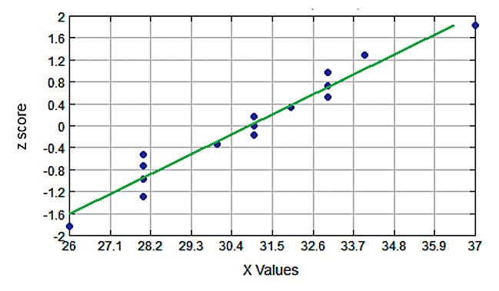
Example: Confidence Interval Estimate of µ with Known σ (3 of 6)
Solution
Sample data appear to be from a normally distributed population.

Slide 36
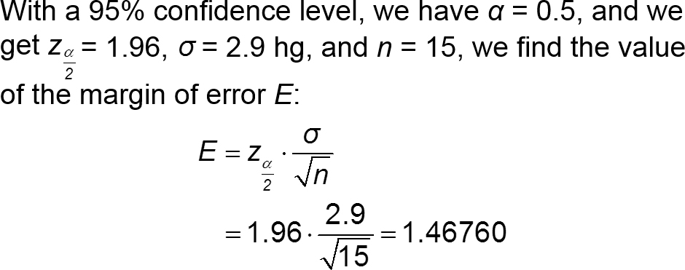
Example: Confidence Interval Estimate of µ with Known σ (4 of 6)
Solution

Slide 37
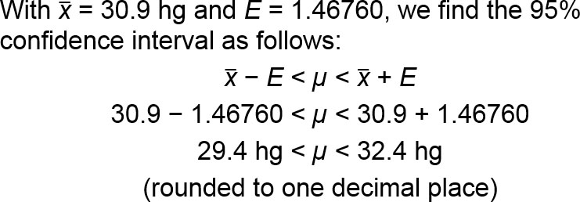
Example: Confidence Interval Estimate of µ with Known σ (5 of 6)
Solution

Slide 38
Example: Confidence Interval Estimate of µ with Known σ (6 of 6)
Solution
Remember, this example illustrates the situation in which the population standard deviation σ is known, which is rare. The more realistic situation with σ unknown is considered in Part 1 of this section.

Slide 39
Choosing an Appropriate Distribution
Choosing between Student t and z (Normal) Distributions
Conditions | Method
σ not known and normally distributed population or σ not known and n > 30 | Use student t distribution
σ known and normally distributed population or σ known and n > 30 (In reality, σ is rarely known.) | Use normal (z) distribution.
Population is not normally distributed and n ≤ 30. | Use the bootstrapping method (Section 7-4) or a nonparametric method.

